Slide 1

Outreach Focus 2018
Workplace and Career Initiatives
  Full Measures™ Apprenticeship Program
  Back-2-Basics™ Land Sharing
  Full Measures™ Workforce Ownership Sharing Initiative
  Stay in School
Full Measures™ Portal and associated training
  Utilize systems & processes developed for education-based outcomes
  Local Church focus and small-group “Huddles”
  Focus on 6 Key Links using “Differential Improvement”
  Soft Skills enrichment
Community Development & Program Funding
  SBA Community Development Corporation
  SBA 504 lending program
  SBA Micro-lending program
  Disaster Relief Program
Copyright © Full Measures Quorum™, 2017

Slide 2
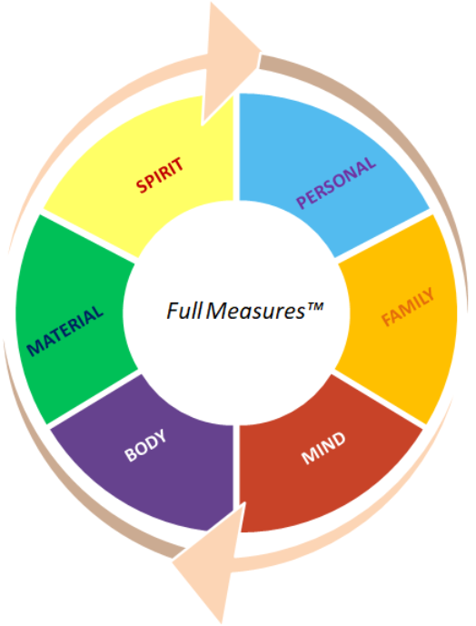
Full Measures™ General Concept
RESOURCES
ITERATIVE GROWTH
PROCESS
GETTING STARTED
START HERE
Manual
Define starting
point in an arena
Iterative Personal progress across an arena
Copyright © 2017 Full Measures Quorum,

Slide 3
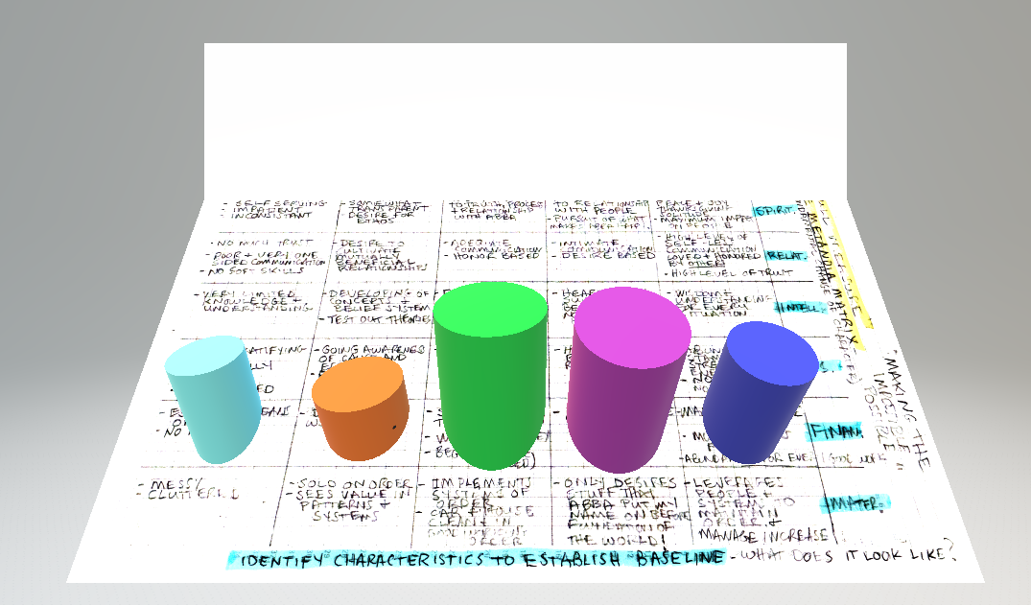

RESOURCES
ITERATIVE GROWTH
PROCESS
GETTING STARTED
Individual Progress
Resources & Tools
Manual
Church
Differential
Improvement
SPIRITUAL
SPIRITUAL TRAINING
ACCOUNTABILYT
SERVICE
FELLOWSHIP
Arena Baseline
Huddles
Individual Growth Plan
PERSONAL
PRAYER/MEDITATION
SERVE/SHARE/GIVE
RIGHT THOUGHT -> RIGHT ACTION
LITMUS TEST FOR LIFE
Defines
Starting
point in
an arena
Personal
Quorum
PROGRESS
Precedence
Scaffolding
PROGRESS
<10 members
PROGRESS
In-person
RELATIONAL
SHARED/INDIVIDUAL SERVICE
SELF-RELIANCE
FAMILY EVENING
COUNSELLING
Assessment
completed
Counseling
completed
Book/s
Metacognition
INTELLECTUAL
RIGHT TRADE/PROFESSION
GRADUATE
STUDY IN EACH ARENA
TRAVEL / MULTI-CULTURAL
On-line App/s
& resources
PHYSICAL
PROPER DIET
DAILY EXERSIZE
MEDICATE AWAY STRESS
Iterative Personal progress
across an arena
Welfare
Services
FINANCIAL
RIGHT PROFESSION/TRADE
PROF/TRADE DEVELOPMENT
PRACTICE FRUGALITY
LIVE ON A BUDGET
SHARE AND GIVE
Microlending
Program
MATERIAL
FRUGALITY
FRIENDSHIPS
HUMILITY
Copyright © 2017 Full Measure Quorum,

